Slide 1

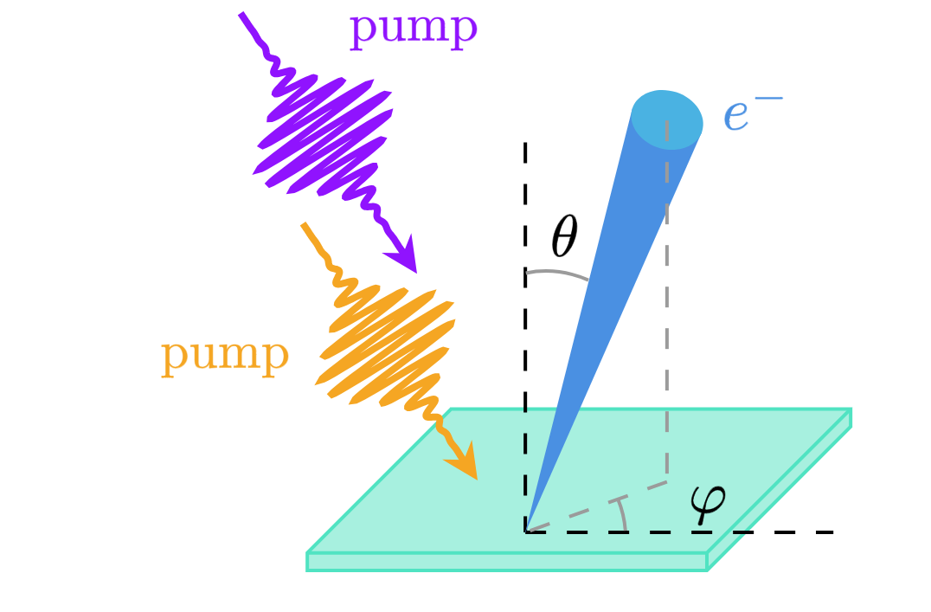
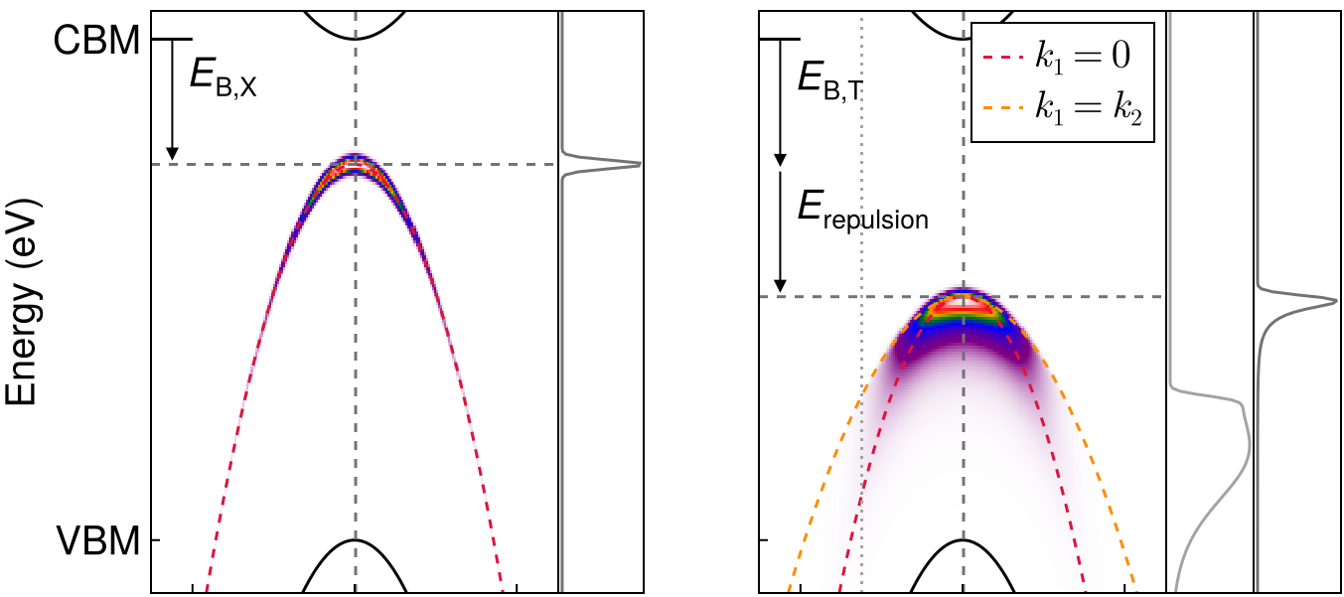
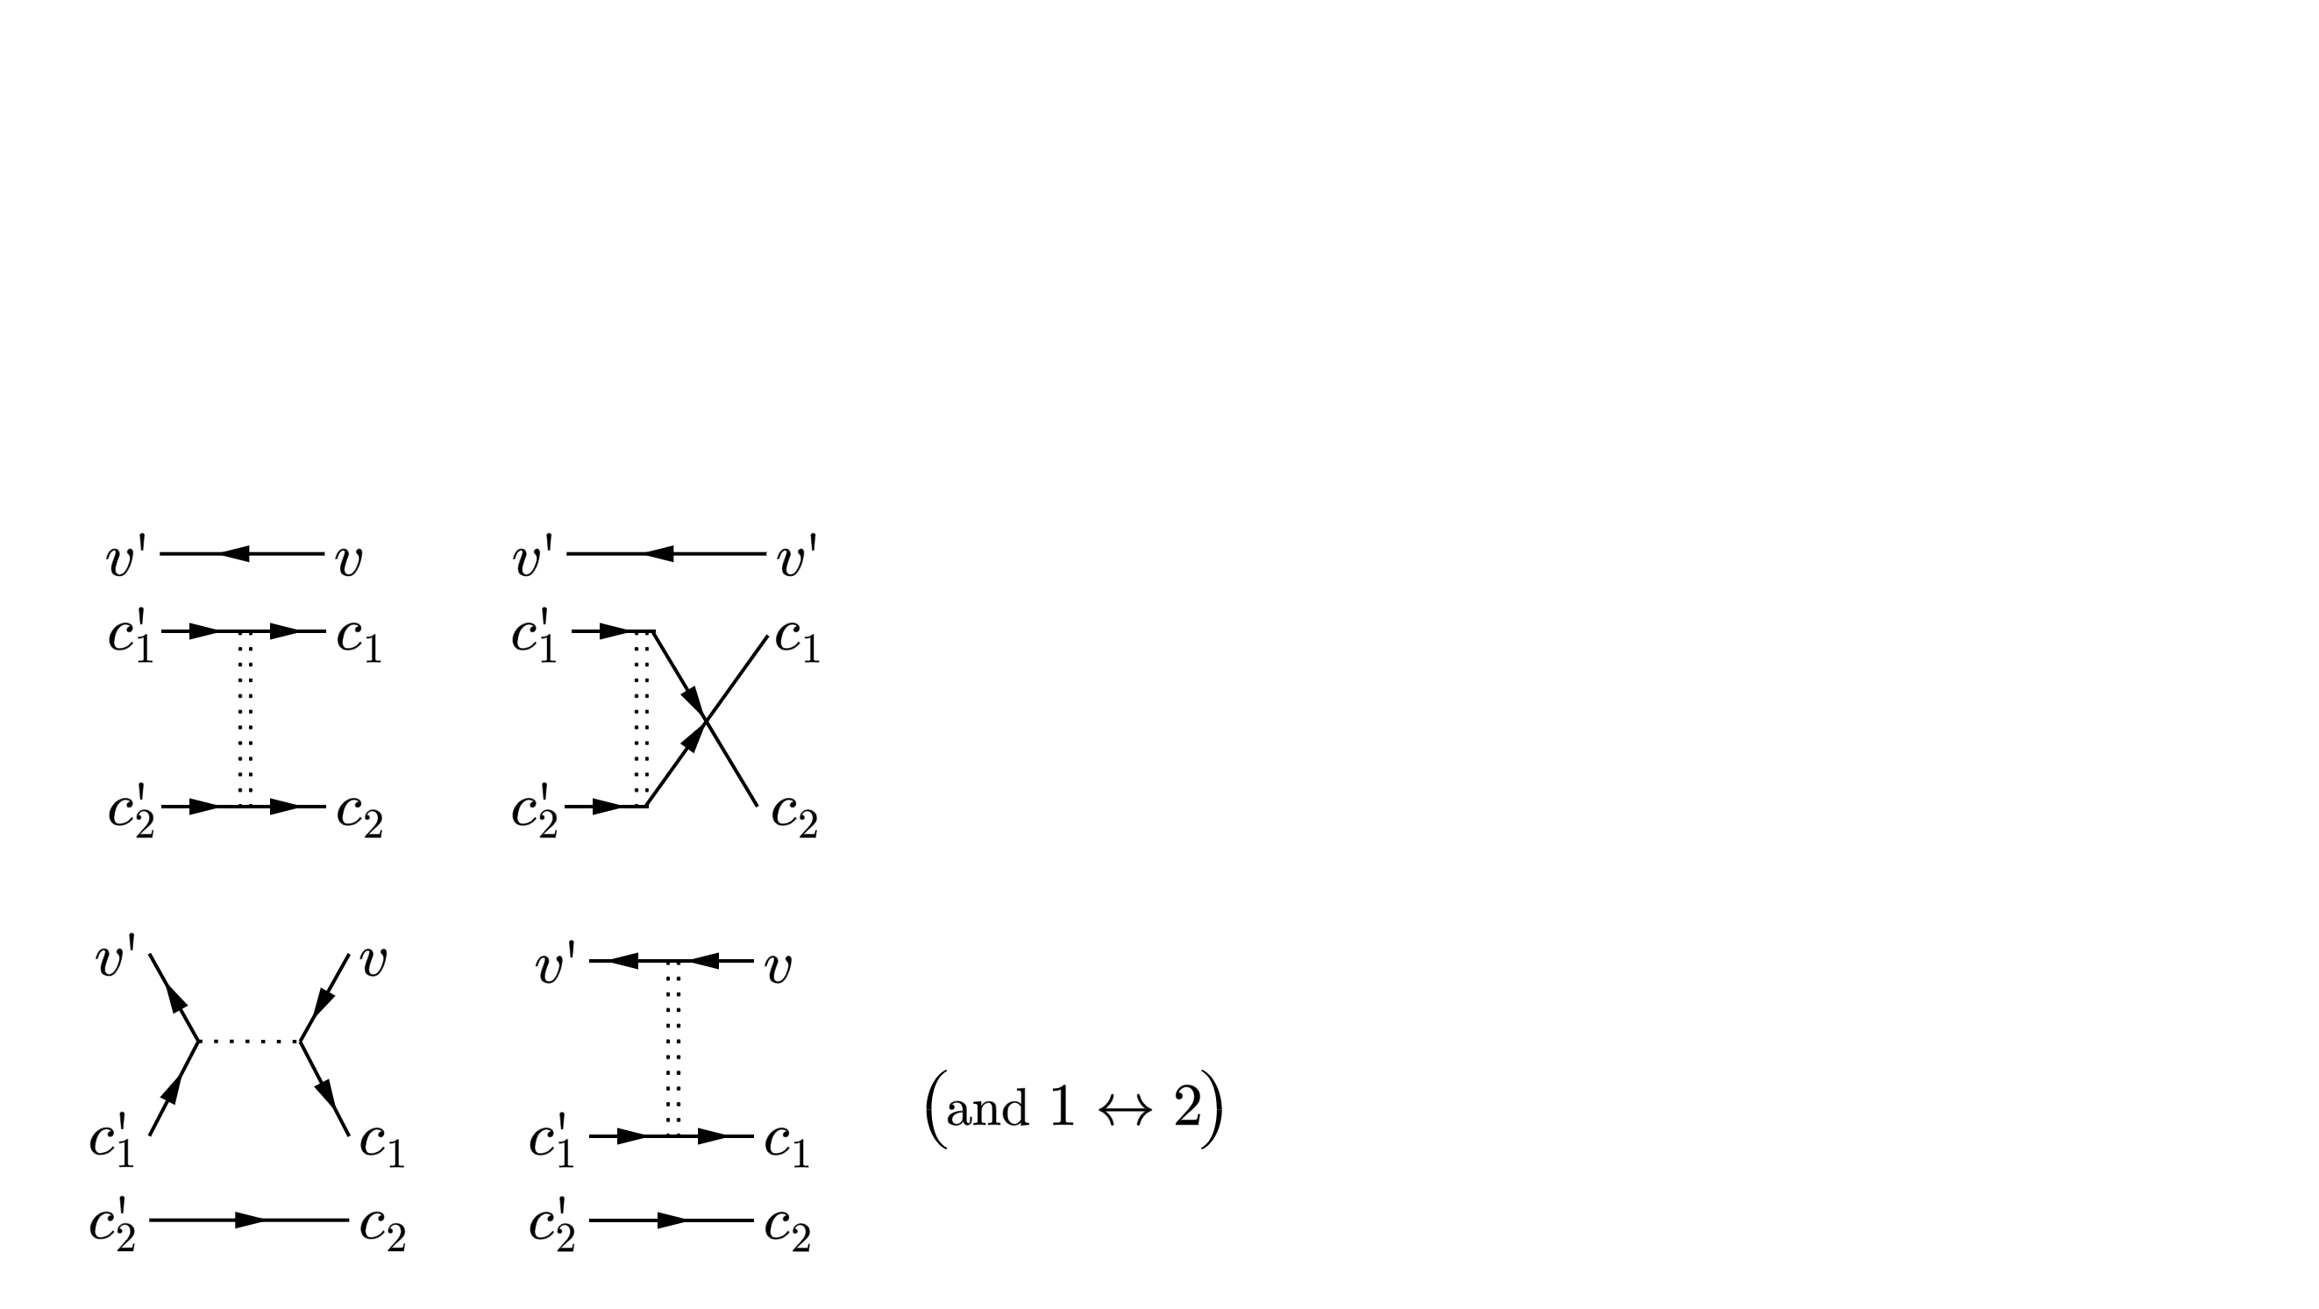
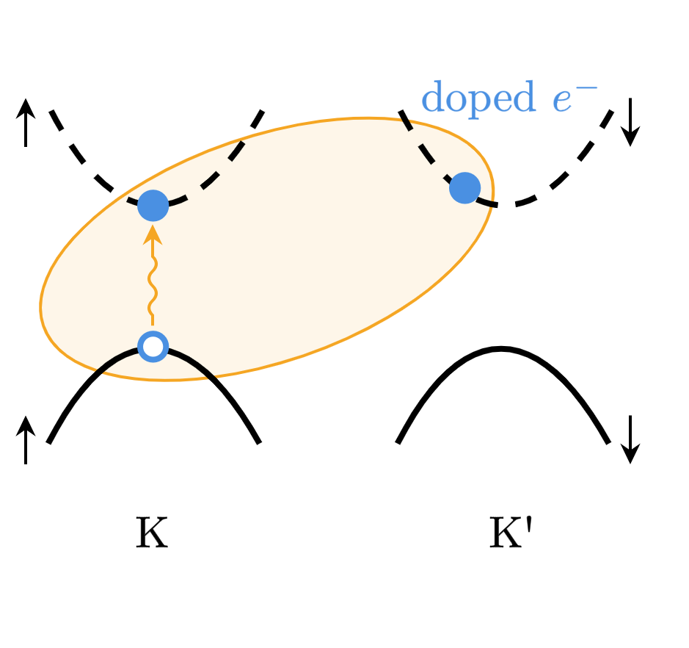
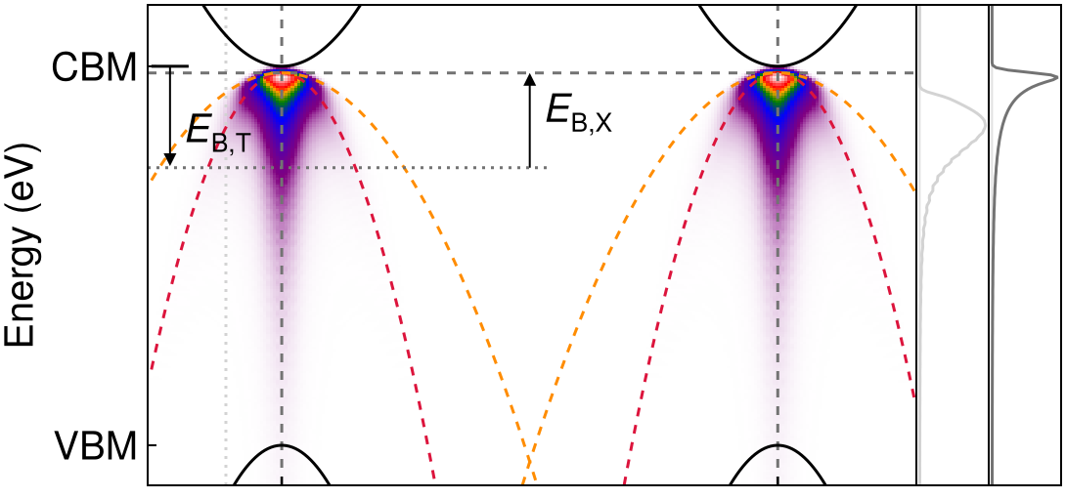
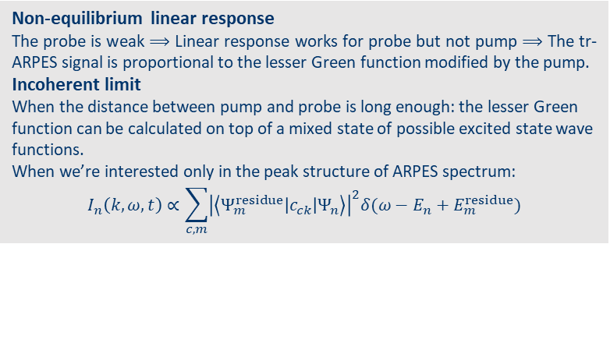
What is the signature of a trion in ARPES?
Jinyuan Wu¹, Zachary Withers², Thomas Allison², Diana Y. Qiu¹
1. Department of Materials Science, Yale University, New Haven, CT 06511, USA 2. Department of Chemistry, Stoney Brook University, Stony Brook, New York 11794, USA
Introduction
Theory of tr-ARPES
Results
tr-ARPES
Recent advancements in ultrafast laser technology makes it possible to first pump the system and then probe the time-resolved evolution of non-equilibrium electronic structure.
Trions
Optical excitations created by pumping in doped systems give rise to trions, which can be simulated using tripartite GW-BSE. Photoluminescence evidence exist for existence of trions. Can we detect them using tr-ARPES as well? What are characteristic signals of trions?
Non-equilibrium linear response
The probe is weak ⟹ Linear response works for probe but not pump ⟹ The tr-ARPES signal is proportional to the lesser Green function modified by the pump.
Incoherent limit
When the distance between pump and probe is long enough: the lesser Green function can be calculated on top of a mixed state of possible excited state wave functions.
When we’re interested only in the peak structure of ARPES spectrum:
$$I_{n}\left(k,ω, t\right)∝\sum_{c,m}{{\left|\left\langle Ψ_{m}^{residue}\left|c_{ck}\right|Ψ_{n}\right\rangle \right|}^{2}δ(ω−E_{n}+E_{m}^{residue})}$$
ARPES image of positive trion
The existence of an additional internal momentum degrees of freedom means the dispersion relation of the trion ARPES is NOT simply a replica of the valence band top. Asymmetry of intensity along linecut can also be observed. The internal repulsion energy of the residue state after photoemission also makes the energy of the signature lower.
exciton signature
trion signature
Theory of trion structure
BSE for trion
Excitonic BSE generalized for trions: adding e-e or h-h interaction lines
Trions in monolayer MoS₂
Previous trion BSE calculation shows intervalley, singlet trion wave function structures, based on which we build two-band models that are then solved by Chandrasekhar ansatz.
ARPES image of negative trion
There are two identical branches of the signature, due to there being two electrons. The energy location of the signature is close to the conduction band because of exciton binding energy in residue state. There is also enhancement of the signature where the internal momentum variable vanishes.
References
Christopher et al. Sci. Rep. 7.1 (2017): 14062.
Perfetto, et al. PRB 94.24 (2016): 245303.
Rustagi et al. PRB 97.23 (2018): 235310.
Drüppel et al. Nat. Comm. 8.1 (2017): 2117.
Berkelbach et al. PRB 88.4 (2013): 045318.
Acknowledgement
We thank precious theoretical inputs from Tom Allison and Zach Withers.

